Slide 1
Quantitative Research Design
Dr Jugindar Singh

Slide 2
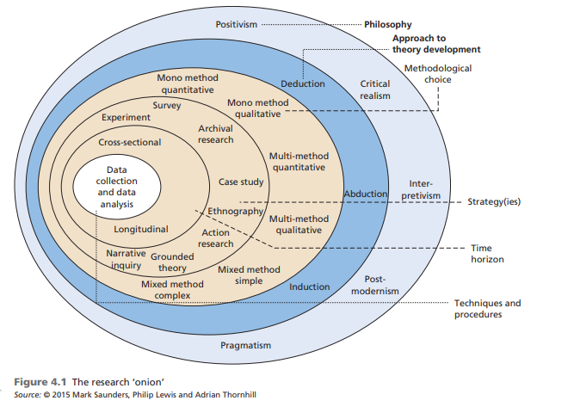
Research Design Saunders et al, (2009)
Saunders, M., Lewis. P & Thornhill, A. (2012) Research methods for business students. 6th ed. Harlow: Pearson.
Figure 5.1 The research ‘onion’
The research ‘onion’

Slide 3
1. Research Philosophy

Slide 4
What is research philosophy
‘Research philosophy is an over-arching term relating to the development of knowledge and the nature of that knowledge’ Adapted from Saunders et al, (2016)
Beliefs and assumptions.

Slide 5
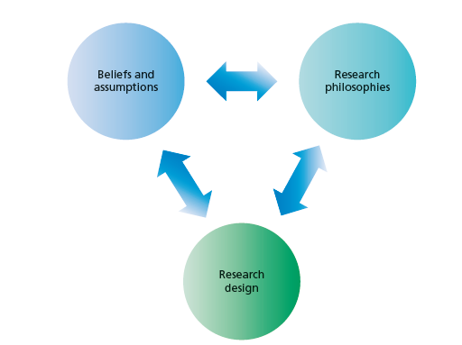
Philosophy:
‘Research philosophy is an over-arching term relating to
the development of knowledge and the nature of that
knowledge’
What you are doing when embarking on research –
developing knowledge in a particular field
Philosophy you adopt contains important assumptions about the way in which you view the world.
Eg: Concerned with Feelings and attitudes OR Facts
Your particular view of the relationship between knowledge and the process by which it is developed.
-Adapted from Saunders et al, (2016)
These include assumptions about human knowledge (epistemological assumptions), about the
realities you encounter in your research (ontological assumptions) and the extent and
ways your own values influence your research process (axiological assumptions).

Slide 6
Ontology, Epistemology and Axiology (Patton, 2002)
Ontology:
The nature of social reality – that is, what do we believe about the nature of
reality?
Ontology relates to whether we believe there is one verifiable reality or whether there exist multiple, socially constructed realities - (Patton, 2002)
Epistemology
Ways of knowing – that is, how do we know what we know?),
Epistemology inquires into the nature of knowledge and truth. It asks the questions:
What are the sources of knowledge? Eg: Smoking is bad for health
How reliable are these sources?
What can one know?
How does one know if something is true?
Axiology
Ethics and value systems – that is, what do we believe is true?

Slide 7
Ontology: ways of constructing reality, “how things really are” and “how things really work”.. Denzin and Lincoln, (1998; 2010)
Ontology
Epistemology
Axiology
Research objects include organisations, management, individuals’ working lives and organisational events and artefacts.
Axiology: The role of values and ethics within the research process.
This incorporates questions about how we, as researchers, deal with both our own values and those of our research participants
Epistemology: different forms of knowledge of that reality, what nature of relationship exists between the inquirer and the inquired? How do we know?
Research Paradigm
Different types of knowledge numerical data to textual and visual data, from facts to interpretations, and including narratives, stories and even fictional accounts –
Eg: you value personal interaction
Methodology: What tools do we use to know that reality?

Slide 8
Ontology
Ontology
What is reality
What shapes reality What is happening
Eg: What is the problem/what are the solutions
Singularity
There is only one reality
Only one set of solution to the problem
2. More than one Reality Depends on how people perceive How people are shaping the reality
Research Philosophy
Epistemology
Epistomology
Knowledge of the reality
How do we collect knowledge
Epistomology
Knowledge can be measured
Knowledge can be interpreted

Slide 9
Ontology
Epistemology
Philosophy
Singularity
There is only one reality
Only one set of solution to the problem
Positivism
Epistemology
Knowledge can be measured
2. More than one Reality Depends on how people perceive How people are shaping the reality
Epistemology
Knowledge can be interpreted
Interpretivism

Slide 10
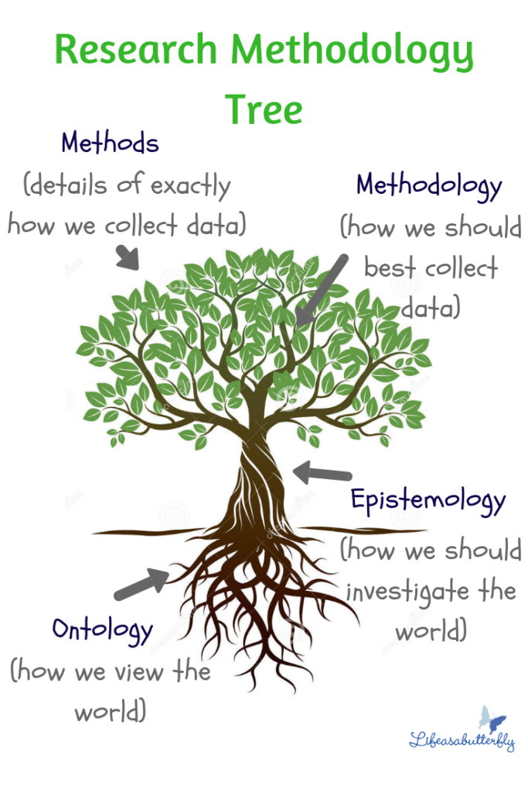
Main research philosophies
Positivism -
The stance of the natural scientist.
2. Realism
What the senses show us as reality is the truth;
Interpretivism
Researchers as ‘social actors’
Pragmatism
Pragmatism asserts that concepts are only relevant where they support action (Kelemen and Rumens 2008).

Slide 11
Positivism Believes in the possibility to observe and describe reality from an objective viewpoint
The stance of the natural scientist.
Adheres to the view that only “factual” knowledge gained through observation (the senses), including measurement, is trustworthy.
Cause and effect/Scientific method
Experimentation and measurement can reveal objective reality
Strive for objectivity
Start with hypothesis and test
Eg: Relationship bet. student’s financial position and academic performance
Positivism - research approaches that employ empirical methods, make extensive use of quantitative analysis, or develop logical calculi

Slide 12
The Positivistic approach
Define your research topic
Literature review
Define your research question(s)
i.e. hypothesis
Deductive
Design data collection
Pilot study
Positivists believe that the best way to investigate the world is through objective methods, such as observations.
Objective Facts
Design data analysis
Collect data
Analyse data
Interpret results
Quantitative
Report your findings
Adapted from Maylor and Blackmon (2005)

Slide 13
3. Pragmatism
Derived from the Greek word “pragma,” which means action, and which is the central concept of pragmatism (Pansiri 2005).
Pragmatism asserts that concepts are only relevant where they support action (Kelemen and Rumens 2008).

Slide 14
Pragmatism
Derived from the Greek word “pragma,” which means action, and which is the central concept of pragmatism (Pansiri 2005).
Pragmatism asserts that concepts are only relevant where they support action (Kelemen and Rumens 2008).
Pragmatists are more interested in practical outcomes than abstract distinctions
Pragmatist ontology, epistemology and axiology are focused on improving practice.
Strives to reconcile both objectivism and subjectivism, facts and values, accurate and rigorous knowledge and different contextualised experiences
Pragmatists adopt a wide range of research strategies, the choice of which is driven by the specific nature of their research problems.
Pragmatist’s view that it is perfectly possible to work with different types of knowledge and methods

Slide 15
2. Research Approach

Slide 16
Approach

Slide 17
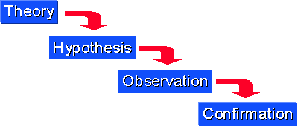
Research Approach Deductive Reasoning
A deductive approach is concerned with “developing a hypothesis based on existing theory, and then designing a research strategy to test the hypothesis Wilson, J. (2010)
Starts with a general rule (a theory) which we know to be true.
Then, from that rule, we make a true conclusion about something specific.
The process of reasoning from known facts to conclusions.
Begins with theory and hypotheses,

Slide 18
Deduction
Characteristics of Deduction
Explaining causal relationships between variables
Establishing controls for testing hypotheses
Independence of the researcher
Concepts operationalised for quantitative measurement
Generalisation
5 sequential stages of testing theory
Deducing a hypothesis
Expressing the hypothesis operationally
Testing the operational hypothesis
Examining the specific outcome of the enquiry
Modifying the theory (if necessary)
Adapted from Robson (2002)

Slide 19
Abduction
Instead of moving from theory to data (as in deduction) or data to theory (as in induction), an abductive approach moves back and forth, in effect combining deduction and induction (Suddaby 2006).
Data are used to explore a phenomenon, identify themes and explain patterns, to generate a new or modify an existing theory which is subsequently tested, often through additional data collection.
Deduction and induction complement abduction
Example: Research on the reasons for high employee absenteeism in a retail store would mean obtaining data that were sufficiently detailed and rich to allow us to explore the phenomenon and identify and explain themes and patterns regarding employee absenteeism. We would then try to integrate these explanations in an overall conceptual framework, thereby building up a theory of employee absenteeism in a retail store. This we would test using evidence provided by existing data and new data and revise as necessary

Slide 20
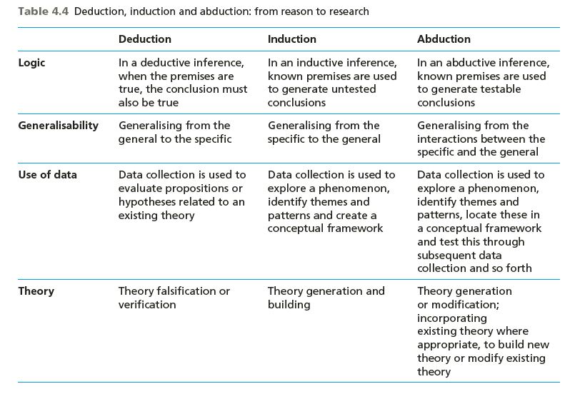

Slide 21
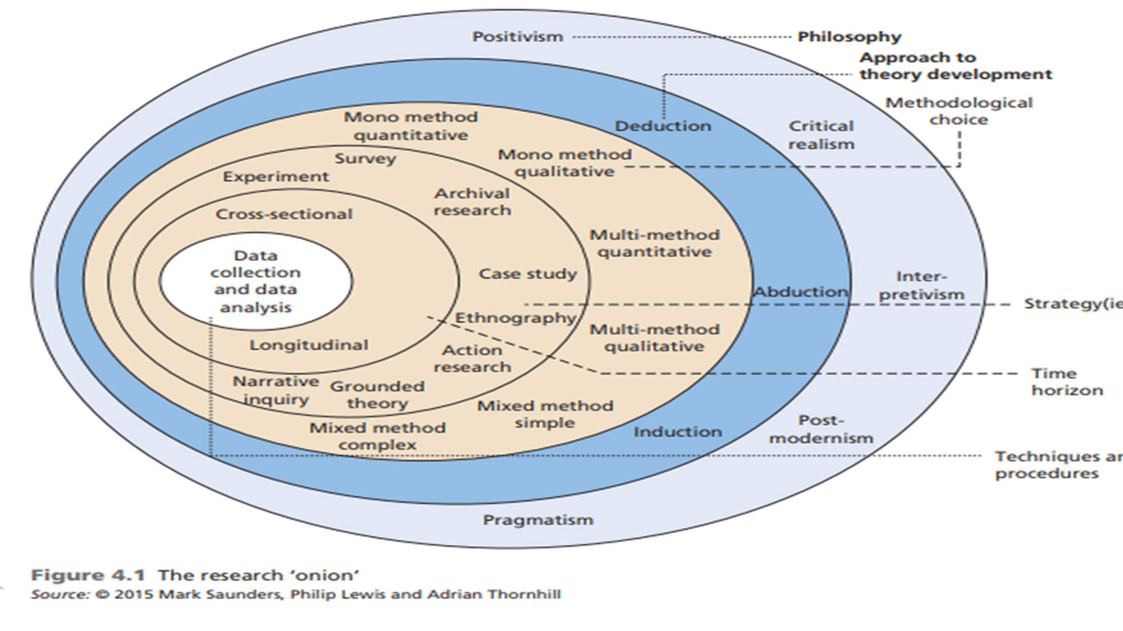
Methodological Choice Quantitative Qualitative

Slide 22
Methodological Choice

Slide 23
Methodological Choice
Mixed Method
Quantitative
Qualitative
Modelling
Empirical
Experimental
Qualitative
Case Study
Phenomenology
Grounded Theory
Basic Qualitative Ethnography

Slide 24
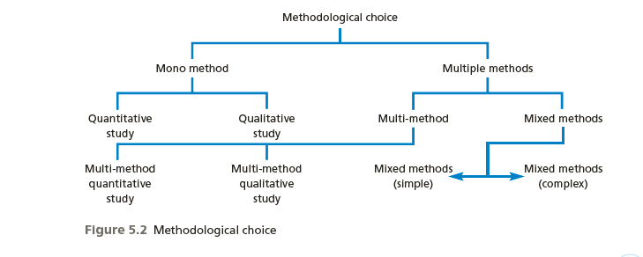
Methodological choices
Quantitative
Qualitative
Mixed Method
Figure 5.4 Research choices
Saunders et al, (2009)

Slide 25
Quantitative research: Predictive
Focuses on verifying hypotheses using typically large amounts of data.
Numerical data
Quantitative research is generally associated with positivism
Usually associated with a deductive approach, where the focus
Large sample
Data collected through Questionnaire
Is on using data to test theory
Example: Investigate employees' absenteeism
♦ quantitative approach: collect ratings, verify user responses (numerical)
♦ qualitative approach: understand why employees absent (words, voice)
Qualitative vs. Quantitative Analysis

Slide 26
Qualitative research: Exploratory
Associated with an interpretive philosophy
Studies participants’ meanings and the relationships between them
Small samples of data
Data in words or voice
Data collection through interviews etc
Eg: structured interviews
Example: investigate employees' absenteeism
♦ quantitative approach: collect ratings, verify user responses (numerical)
♦ qualitative approach: understand why employees absent – Interview (words, voice)
Qualitative vs. Quantitative Analysis

Slide 27
Research Strategy

Slide 28
Research Strategies
A research strategy usually has
♦ A goal: something it can be used for
♦ A procedure: steps to follow to achieve results
♦ A set of techniques involved in the procedures
Experiment Action research
Grounded theory Survey
Ethnography Case study
Phenomenology
Archival research

Slide 29
Research Strategies - Survey A Survey collects information
A survey is a system for collecting information from or about people to describe, compare, or explain their knowledge, attitudes, and behavior (Fink, 2003).
A survey strategy is often associated with a quantitative method using a questionnaire
Collecting large amounts of data from a Sample to address the who, what, where, when and how of any given topic or issue
Example: Surveys of consumer decision making, customer satisfaction, job satisfaction, the use of health services, management information systems,

Slide 30
Case Study
A case study is an in-depth inquiry into a topic or phenomenon within its real-life setting (Yin 2014).
“A case study is an empirical study that investigates a contemporary phenomenon in depth and with its real-life context” (Yin, 2009, p18)
Patton (1990) suggests that case studies are valuable in creating deep understanding of particular people, problems or situations in comprehensive ways.
Once defined, case study research sets out to understand the dynamics of the topic being studied within its setting or context
Saunders 2016

Slide 31
Research Strategies: Experiment
The purpose of an experiment is to study the probability of a change in an independent variable causing a change in another, dependent variable.
Eg: Customer services training (IV) of IT telephone support staff will not lead to a significant improvement in users’ satisfaction (DV) feedback
To do experiment, 2 groups
Given Training
(Experimental Group)
Customer Satisfaction
Not Given Training
(Control Group)

Slide 32
5. Time Horizon Longitudinal Cross Sectional

Slide 33
5. Time Horizon
Cross Sectional
A study can be done in which data are gathered just once, perhaps over a period of days or weeks or months, in order to answer a research question
Longitudinal
The researcher might want to study people or phenomena at more than one point in time in order to answer the research question.
Eg: To study employees‘ behavior before and after a change in the top management, so as to know what effects the change accomplished. Data are gathered at two different points in time

Slide 34
Time Horizon
Time of Data Collection
Study at One Point in Time
Study Over Time
Longitudinal
Cross-sectional
Trends in
the same
population
over time
Changes
in a
subpopulation
group identified
by a common
characteristic
over time
Changes
in the
same
people
over time
Attitudes
and
Practices
Customer
Satisfaction
Program
Evaluation
Panel
Group
Comparisons
National
Survey
Trend
Cohort

Slide 35
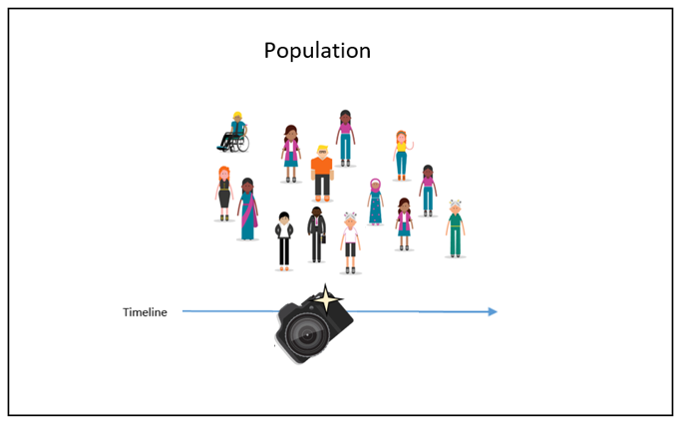
TIME HORIZON: CROSS-SECTIONAL
A study can be done in which data are gathered just once, perhaps over a period of days or weeks or months, in order to answer a research question.
Example: Data were collected from customers just once to study their satisfaction level.

Slide 36
LONGITUDINAL STUDIES
The researcher might want to study people or phenomena at more than one point in time in order to answer the research question.
Eg: To study employees‘ behavior before and after a change in the top management, so as to know what effects the change accomplished. Data are gathered at two different points in time.
PANEL STUDIES
Panel studies describe information about the same cases at two or more points in time. (referred to as waves)
Respondents interviewed at wave one of a survey are interviewed again at wave two,.
Eg: Effects of smoking at two points in time
TREND STUDIES
Trend studies use cross-sections at two or more points in time to examine change over time. The Virginia Slims Opinion Poll asked various questions about women at six points in time. Example Opinion pools study over three years
Cohort surveys
Respondents are followed from an identical point in their life onwards, often from birth. These surveys prove very useful to study child development over time, change in marital circumstances or health for instance among people belonging to the same
generation.

Slide 37
6. Data Collection and Analysis

Slide 38
6. Data Collection and Data Analysis
Sampling – Sample Size
Data Collection Instrumentation
Data Processing
Data Analysis (Reliability and Validity)

Slide 39
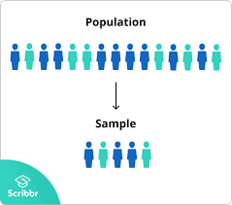
Populations and Samples
Sampling
Target
Population
Sample
Sample
Nonprobability sampling
Most common sampling methods are:
Purposive sampling/Judgement sampling
Select participants according to pre-selected criteria relevant to a particular research question.
Quota sampling
If the researcher needs a specific number of participants, quota sampling is better

Slide 40
Sampling Quantitative
1- Defining the population: Who is qualified to provide data
Sampling begin with precisely defining the target population.
Ensure the qualification criteria is right
2- Determining the sample frame: A listing of the target population
The sampling frame is a representation of all the elements in the population from whish the
sample is drawn.
3- Determining the sampling design: ( Two types )
Probability sampling, the elements in the population have some known probability of being
selected as sample subject.
Nonprobability sampling, the elements do not have a known chance of being selected as
sample subject.
4- Sample size – How many respondents
Sample size to represent the population
Quantitative: 80-100 respondents (agree with Supervisor) Qualitative : 5-10 (agree with Supervisor)

Slide 41
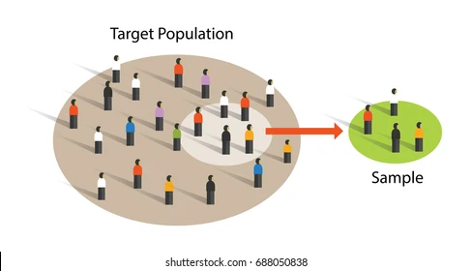
Types of Quantitative Sampling
Quantitative Sampling Strategies
Probability Sampling
Nonprobability Sampling
Simple Systematic Stratified Multistage Cluster
Random Sampling Sampling Sampling Sampling
Sampling
Convenience Snowball Quota Purposive

Slide 42
Sampling: Sample size Saunders et al., 2012
For a general study, you should expect to undertake between 5 and 30 interviews (Creswell 2013).
Saturation
A situation in data analysis where participants’ descriptions become repetitive and confirm previously collected data
An indication that data analysis is complete
When data analysis is complete, data collection is terminated
Saturation occurs when adding more participants to the study does not result in additional perspectives or information. Glaser, B. & Strauss, A. (1967)

Slide 43
Instrumentation/ Questionnaire
Questionnaires are a popular means of collecting data.
Describe the questionnaire used in the study
Is it original? If any items are taken from existing questionnaire,
identify the sources (adopted/adapted)
The structure and the question categories (demographic/rating questions)
Describe the scaling methods used and state the reasons for choosing them
Issues on validity and reliability
Was Pilot test done to check the clarity and appropriateness of the survey questionnaire
(Attach a sample of the questionnaire)
Remember: Questions are ADOPTED or ADAPTED

Slide 44
Data Collection Based on Who Completes or Records the Data
Who completes or records the data?
Participant
Researcher
Mailed
Questionnaire
Electronic
Questionnaire
One on one
One
To a
Group
Over
Telephone
Individual
Interview
Focus Group
Interview
Telephone
Interview

Slide 45
Describe how the questionnaire will be administered and discuss problems encountered
• Internet- or intranet-mediated,
• postal,
• delivery and collection,
• telephone
• interview
State the steps in data collection ie:
• What method was used
Sample Size
• How many questionnaires/respondents
• How was the response rate and follow up
If pilot testing was done, state the reliability and validity testing results and what amendments done to
Data collection

Slide 46
Data Processing Data Analysis

Slide 47
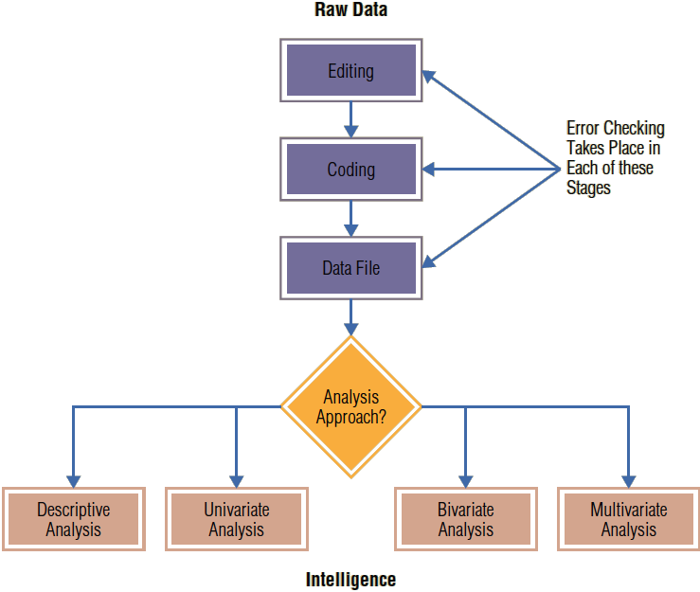
Data Processing and data Analysis

Slide 48
Editing, coding and tabulation
Editing Data
The process of checking and adjusting responses in the completed questionnaires for omissions, legibility, and consistency and readying them for coding and storage
CODING
The process of identifying and classifying each answer with a numerical score or other character symbol. Usually, a number to each response
If male=1 and if female=2
TABULATION
Tabulation is the process of summarizing raw data and displaying the same in compact form (i.e., in the form of statistical table) for further analysis
Data Transformation
Converting some of the data from the format in which they were entered to a format most suitable for particular statistical analysis.

Slide 49
Data Analysis
In data analysis we have three objectives:
getting a feel for the data,
testing the goodness of data, and
testing the hypotheses developed for the research.

Slide 50
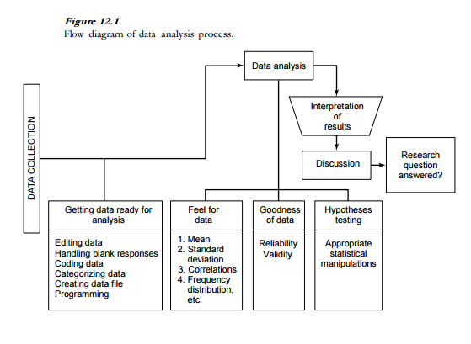
Data Analysis – Uma Sekaran

Slide 51
Thank You

