Slide 1
Topic 5 Scales
Dr Jugindar Singh

Slide 2
Scales: The Hierarchy of Levels
Ratio
Continuum of Values
Absolute zero
Interval
Equal intervals
Distance is meaningful
Ordinal
Preserves order
Attributes can be ordered
Nominal
Uniquely classifies
Attributes are only named; weakest

Slide 3
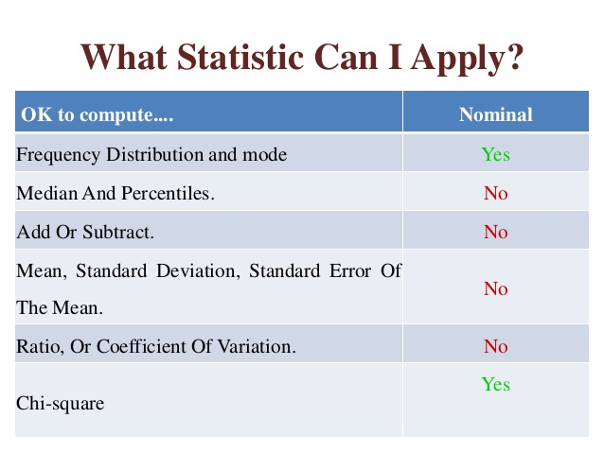
Nominal Scale
Consists of categorizing items into groups
It is used to indicate categories
Numbers are only used as labels
It has no numerical significance
It does not represent any order or distance.
Example of nominal scale:
Gender | Code
Male | 1
Female | 2
A nominal scale assigns a value to an object for identification or classification purposes only –
Zikmund

Slide 4
Ordinal Scale
Ordinal scale: rank-orders categories in some meaningful way.
What is the highest level of education you have completed?
O Less than High School
O High School/GED Equivalent
O College Degree
O Masters Degree
O Doctoral Degree
Even though differences in the ranking of objects/persons are clearly known, we do not know their magnitude.
Ordinal scales allow things to be arranged in order based on how much of some concept they possess.
Zikmund

Slide 5
Interval Scale
To measure the distance between any two points on the scale. Numerical distances between intervals
Has measurements where the difference between values is meaningful
The differences between points on the scale are measurable and exactly equal.
EG: The difference between a 110 degrees F and 100 degrees F is the same difference as between 70 degrees F and 80 degrees F.
Examples
Temperature, in degrees Fahrenheit
IQ test (intelligence scale).
Voltage e.g. 110 and 120 volts (AC); 220 and 240 volts (AC) and etc.
Scales that have both nominal and ordinal properties, but that also capture information about differences in quantities of a concept from one observation to the next. No true zero Zikmund

Slide 6
Interval scale

Slide 7
Ratio Scale
Represent absolute quantities
Has an absolute (in contrast to an arbitrary) zero point, which is a meaningful measurement point.
Eg: Sales volume, income in dollars,
length, area or volume, height, weight
Test scores
Income
Height
Weight
Ratio scales represent the highest form of measurement in that they have all the properties of interval scales with the additional attribute of representing absolute quantities. Zikmund

Slide 8
Recap: Scales
Scale | Description | Example
Nominal | The values “name” the attribute uniquely. The value does not imply any ordering of the cases | Gender 1 = Male 2 = Female
Ordinal | When attributes can be rank-ordered… Arranged from lowest to highest | Education Level 1= Diploma 2= Degree 3=Masters 4=Phd
Interval | An interval scale measures quantitative differences, not just relative The distance between attributes does have meaning. Arbitrary zero (eg Zero degree F has value) | Temperature (in Fahrenheit), the distance from 30-40 is same as distance from 70-80 Time
Ratio | Continuum of values Aa non-arbitrary zero point True zero (eg Zero income) | Size, weight, Height, Age Income

Slide 10
Thank You

