Slide 1


Topic 7 SPSS Descriptive Statistics
Dr Jugindar Singh

Slide 2

Descriptive Statistics

Slide 3
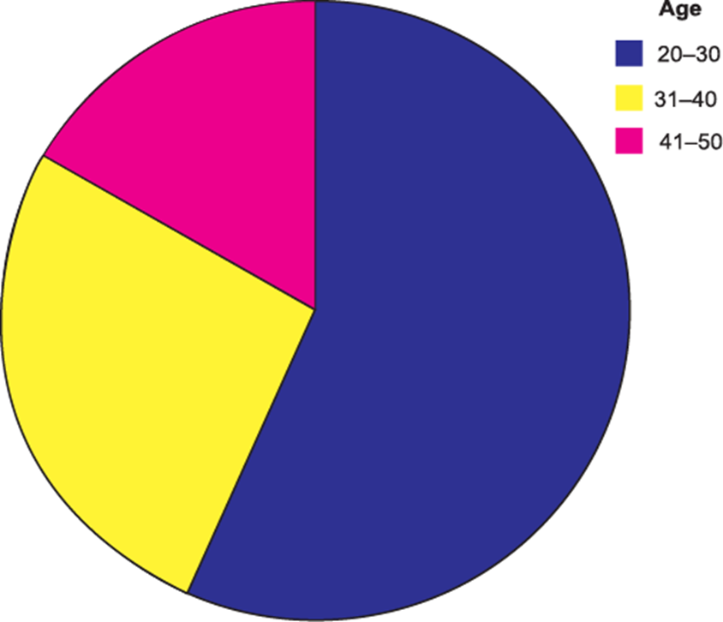
Descriptives
Frequencies
  This analysis produces frequency tables showing frequency counts and percentages of the values of individual variables.
Descriptives
  This analysis shows the maximum, minimum, mean, and standard deviation of the variables
Explore
  Linear Regression estimates the coefficients of the linear equation

Slide 4
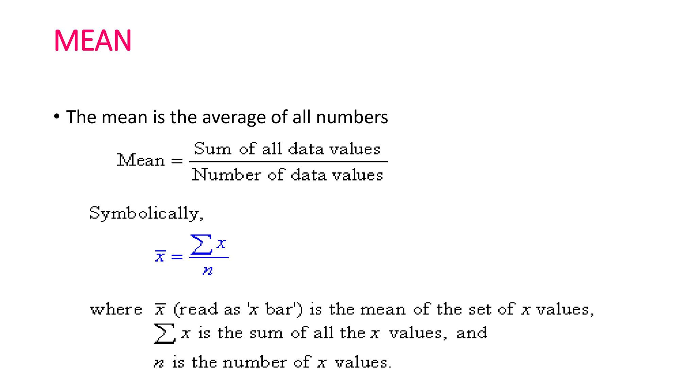
Measures of Central Tendency
Measures of central tendency are measures of the location of the middle or the center of a distribution.
Mean
  The arithmetic mean (AM), commonly known as mean or average, is the most often used measure of central tendency. The mean is computed by adding all the data values together and dividing by n, where n represents the total number of data values. Symbolically,

Slide 5
Median
Example
Ordered Array includes:
3 4 5 7 8 9 11 14 15 16 16 17 19 19 20 21 22
There are 17 terms in the ordered array.
Position of median = (n+1)/2 = (17+1)/2 = 9
The median is the 9th term, 15.
The median of a set of scores represents the middle value (50th percentile) when the scores are arranged as an array in ascending or descending order.
To calculate the median, first rank the scores in ascending or descending order and follow these two guidelines:
  For an odd number of scores, the median is the middle score.
  For an even number of scores, the median is the mean (arithmetic average) of the two middle scores.

Slide 6
Mode
The mode represents the most frequently occurring score.
When two scores occur with the same greatest frequency, each one equals the mode and the data set is considered bimodal.
When more than two scores occur with the greatest frequency, the data set is said to be multimodal.
35
41
44
45
37
41
44
46
The mode is 44.
There are more 44s
than any other value.
37
43
44
46
39
43
44
46
40
43
44
46
40
43
45
48

Slide 7
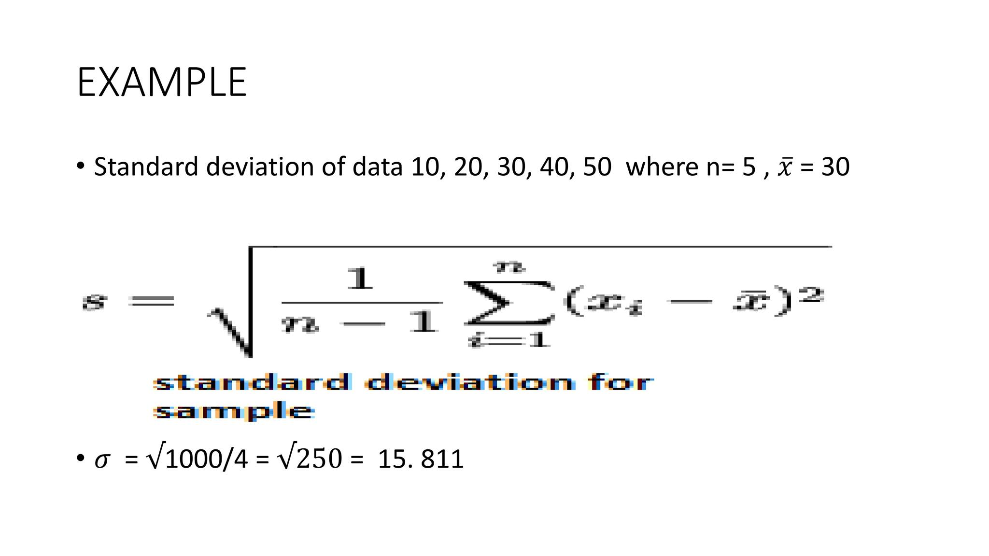
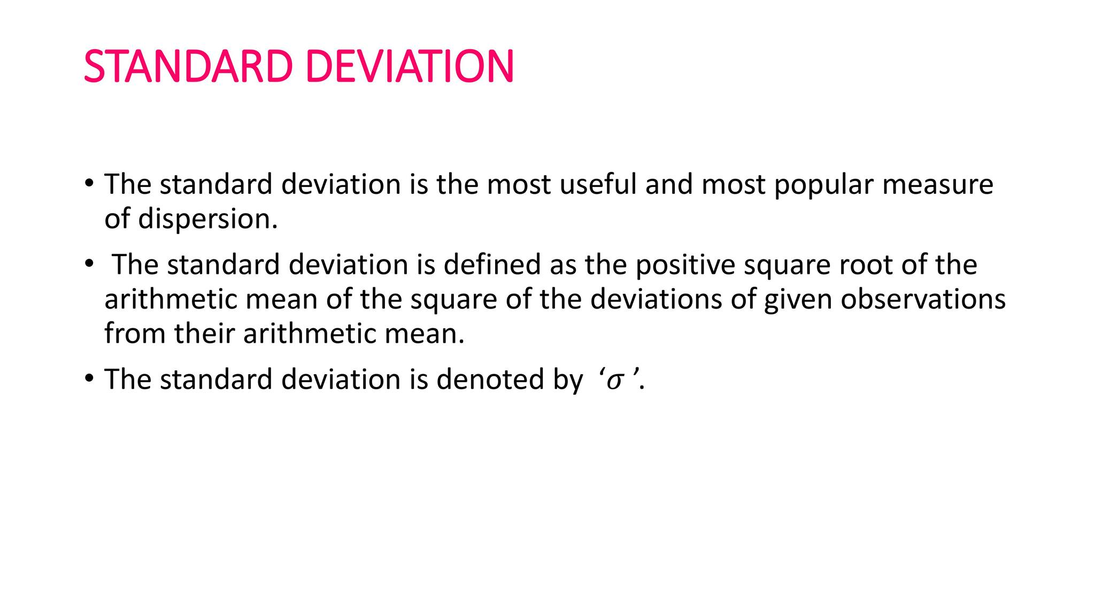
Measures of Dispersion
Measures of dispersion or variability give us information about the spread of the scores in our distribution.
Standard Deviation
The standard deviation (SD) plays a dominating role for the study of variation in the data and it is the most widely used measure of dispersion.

Slide 8
Variance
Variance is another absolute measure of dispersion. It is defined as the average of the squared difference between each of the observations in a set of data and the mean.
The variance is denoted by and is calculated as:

Slide 9
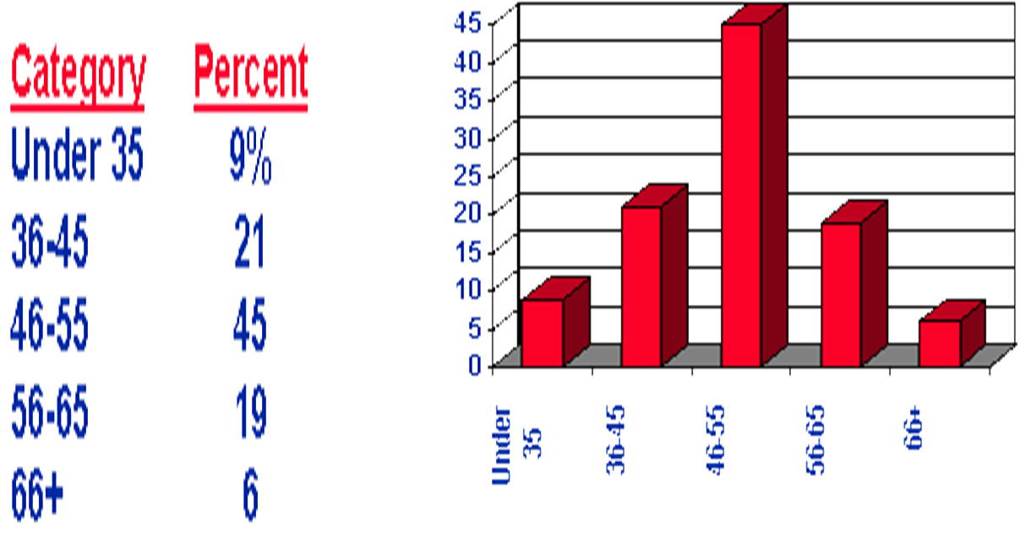
Descriptive Statistics
Types of descriptive statistics:
Organize Data
  Tables
    Frequency Distributions
    Relative Frequency Distributions
  Graphs
    Bar Chart
    Histogram
    Stem and Leaf Plot

Slide 10
Descriptive Statistics
Number
Frequency Count
Percentage
Measures of Central Tendency
  Mean
  Median
  Mode
Variability
Variance and standard deviation
Graphs
Normal Curve
Mode – the most frequently occurring observation
Median – the middle value in the data (50 50 )
Mean – arithmetic average
Describe what's going on in our data.

Slide 11

Your Respondents

Slide 12
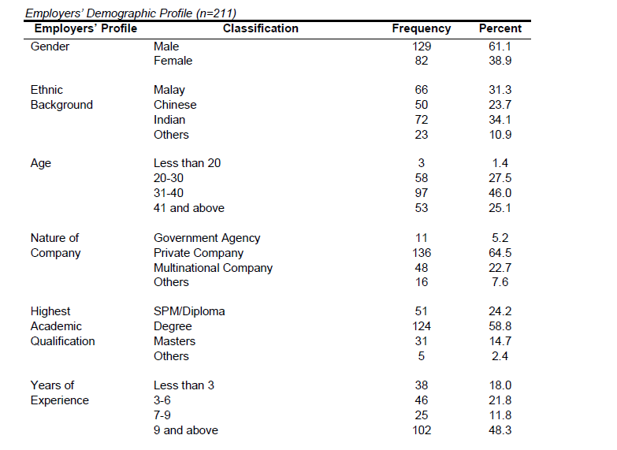
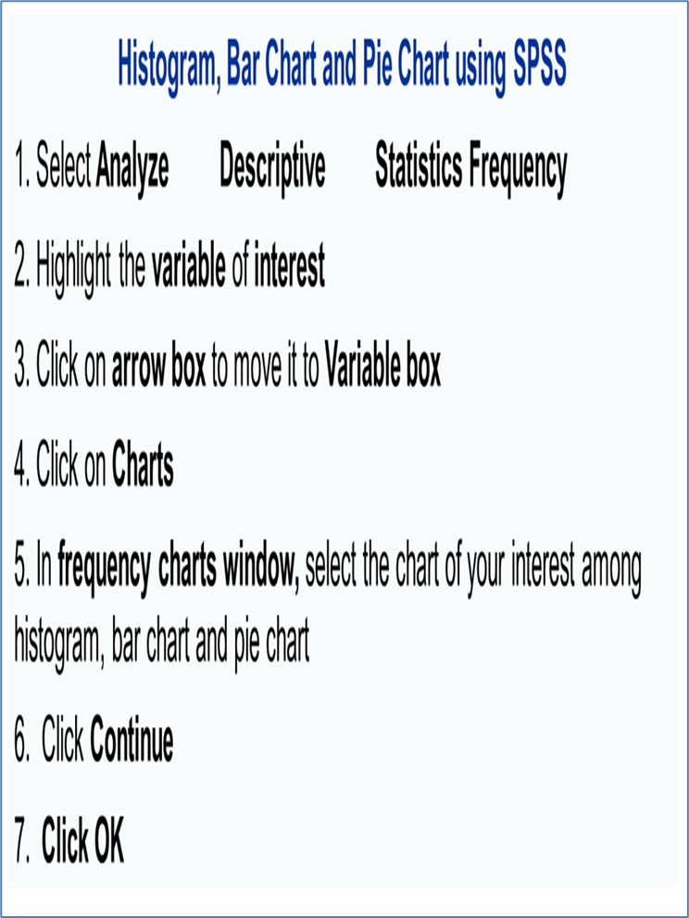
Respondents
Analyze –
Descriptive Statistics
Frequency

Slide 13
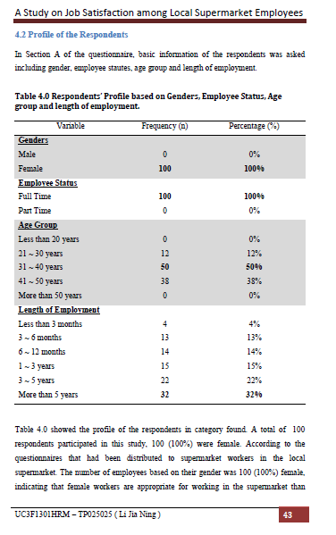
Demographics
Present Demographics Describe the sample:
The age, gender, or relevant related information on the population
Summarize the demographics of the sample, and present in a table format after the narration (as per sample) (Simon, 2006).
Otherwise, the table is included as an Appendix and referred to in the narrative of chapter four

Slide 14
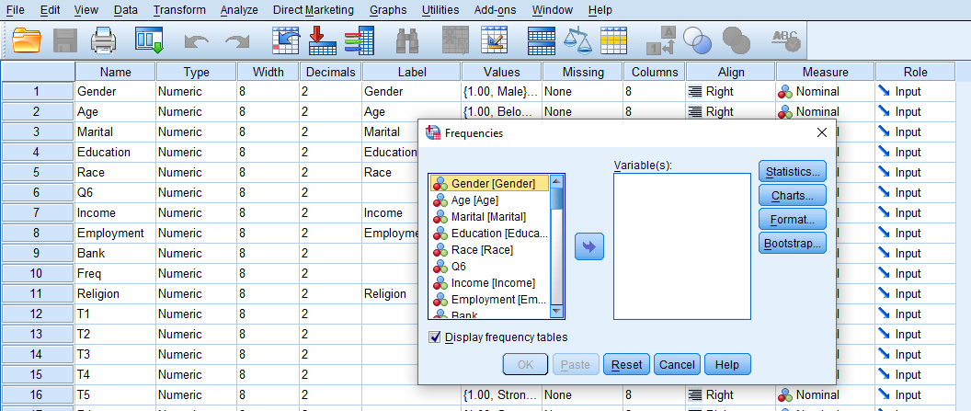
Frequencies
Click ‘Analyze,’ ‘Descriptive statistics,’ then click ‘Frequencies’
Click gender and put it into the variable box.
Click ‘Charts.’
Then click ‘Bar charts’ and click ‘Continue.’
Click OK

Slide 15
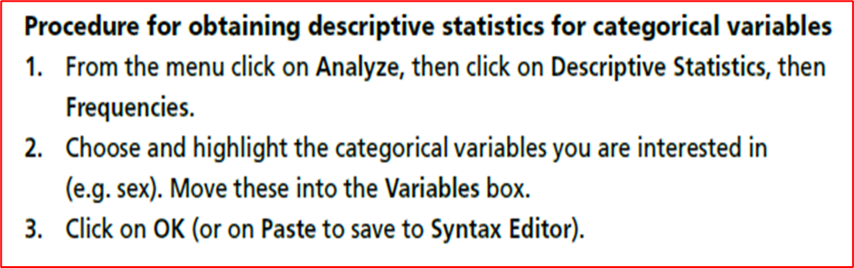
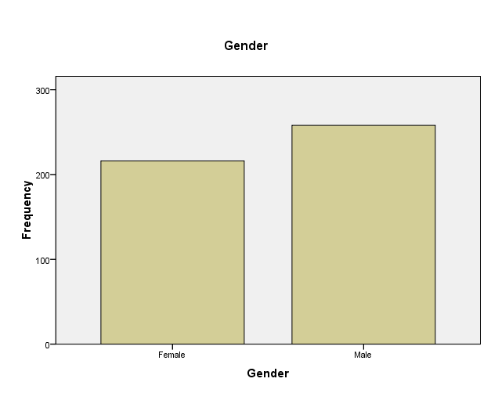
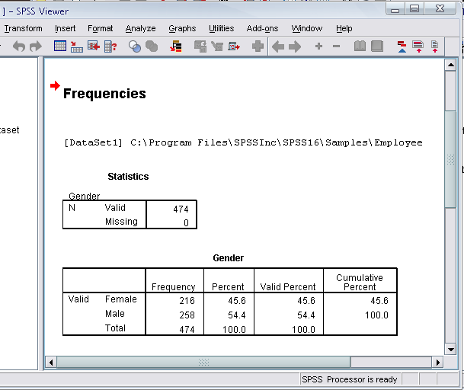
Frequencies

Slide 16
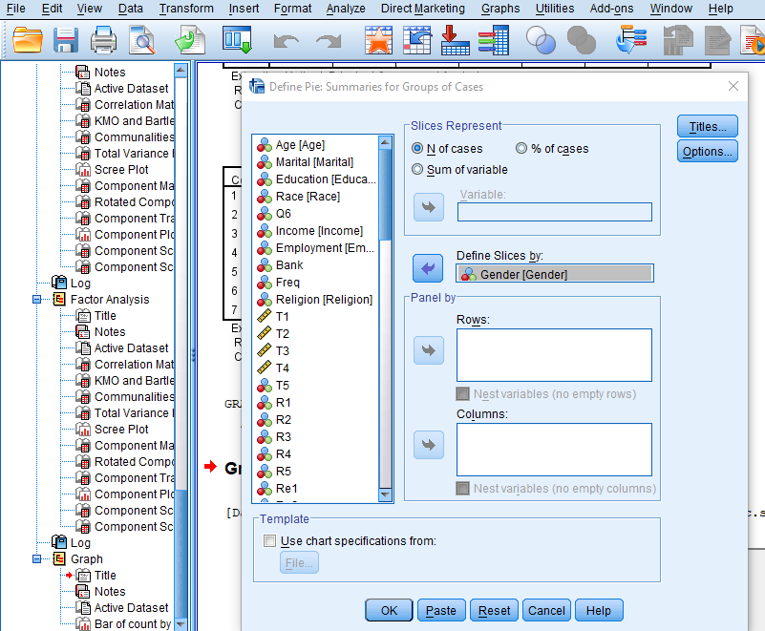
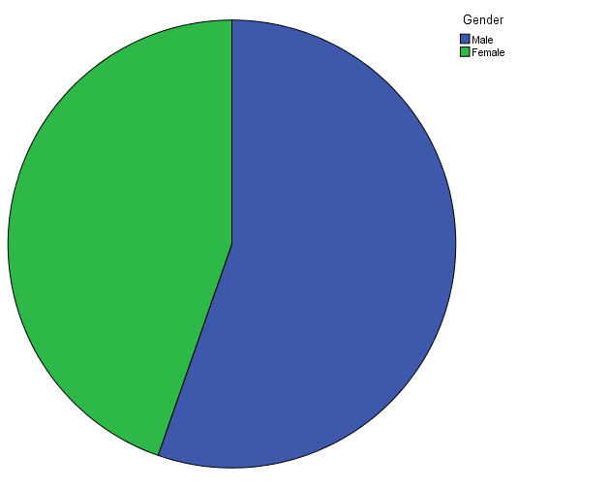
Using Graphs to Describe and Explore data
– BarGraphs, Histograms etc
Procedure for creating a Pie Chart
1. From the menu click on Graphs, then select Legacy Dialogs. Choose Pie.
2. Click on your variable of interest and move it into the Variable box. This should be a continuous variable (e.g. Responsiveness).
3. If you would like to generate separate histograms for different groups (e.g. male/female), you could put an additional variable (e.g. sex) in the Panel by: section. Choose Rows if you would like the two graphs on top
of one another, or Column if you want them side by side. In this example,
I will put the Gender variable in the Column box.
4. Click on OK

Slide 17
Descriptive
Mean
Median,
Standard Deviation
Your Data

Slide 18
DESCRIPTIVE ANALYSIS
The mean and standard deviation values for all of the study variables/construct.
Based upon the scale of 1 to 5, the mean scores can be explained as:
a mean score that is less than 2 is rated as low,
a mean score between 2 to 4 is rated as average,
○ a mean score of greater 4 is rated as high.

Slide 19
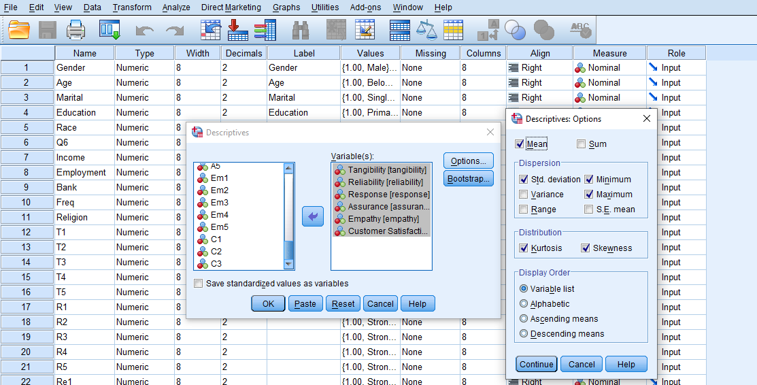
Descriptives
Click ‘Analyze,’ ‘Descriptive statistics,’ then click‘ Descriptives’
Click ‘Variables and put it into the variable box.
Click Options
The options allows you to analyze other descriptive statistics besides the mean and Std.
Click ‘variance’ and ‘kurtosis’
Finally click ‘Continue’-----Click Ok

Slide 20
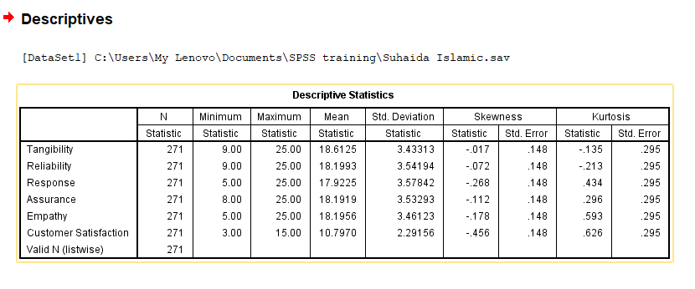
Descriptives

Slide 21
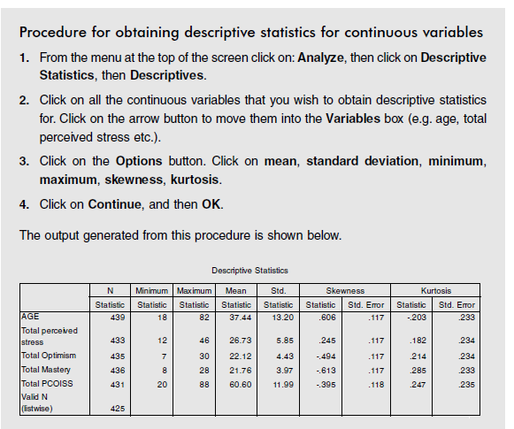
Descriptive statistics

Slide 22

Exploring your data

Slide 23
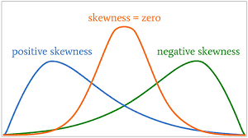
Measures of Shape
One is typically interested to know how well the distribution can be approximated by the normal distribution.
Skewness
When the distribution of item in a series is perfectly symmetrical, a curve is technically described as normal curve and the relating distribution as a normal distribution.

Slide 24
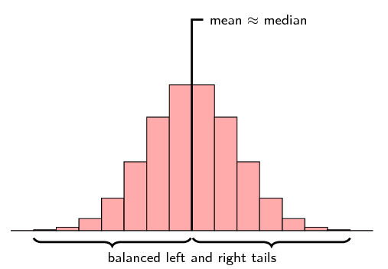
Normal Curve Shape
For symmetric distributions, the mean is approximately equal to the median.
The tails of the distribution are the parts to the left and to the right, away from the mean

Slide 25
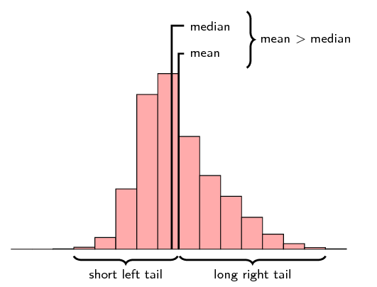
Positively skewed distribution OR Right skewed
Positively skewed distribution: If the frequency curve has longer tail to the right of the distribution, it is known as positively skewed distribution.
In this case, mean > median > mode.
For a right skewed distribution, the mean is typically greater than the median. Also notice that the tail of the distribution on the right hand (positive) side is longer than on the left hand side.

Slide 26
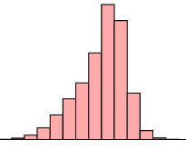
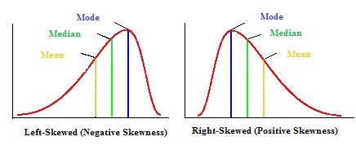
Negatively skewed distribution OR Left Skewed
Negatively skewed distribution: If the frequency curve has longer tail to the left of the distribution, it is known as negatively skewed distribution .
In this case, mean < median < mode.

Slide 27
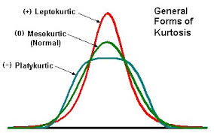
Kurtosis
A curve having relatively higher peak than the normal curve is known as leptokurtic.
On the other hand, if the curve is more flat-topped than the normal curve, it is called platykurtic.
A normal curve itself is called mesokurtic, which is neither too peaked nor too flat-topped

Slide 28
General forms of Kurtosis

Slide 29
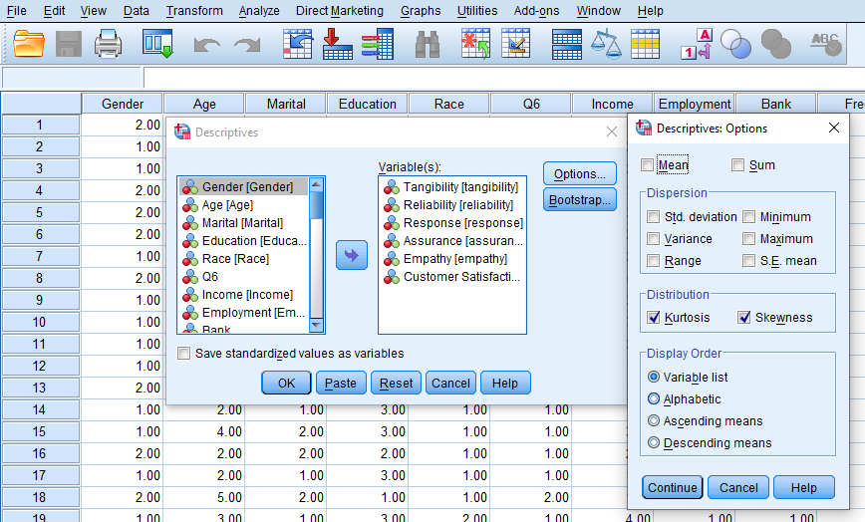
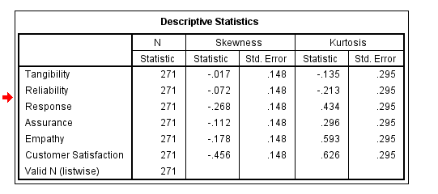
Testing Normality – Skewness and Kurtosis
Analyse – Descriptives
Move in the Variables
OPTIONS – select Skewness and Kurtosis

Slide 30
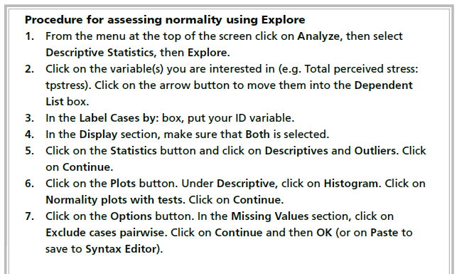
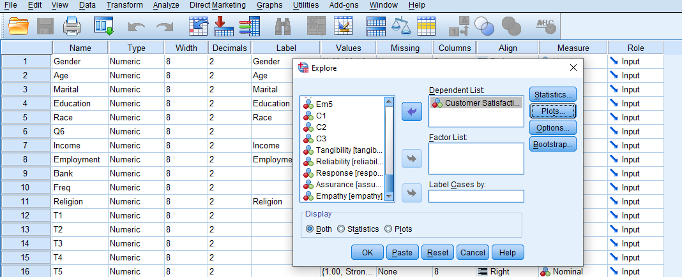
EXPLORE – Normality Test
Click Analyze > Descriptive Statistics > Explore.
Move the Variable in the ‘Dependent List’
Press STATISTICS and select ‘Descriptives’ and
‘Outliers
Press PLOTS and select ‘Stem and Leaf’ Histogram
and ‘Normality Plots with Tests’. Click OK

Slide 31
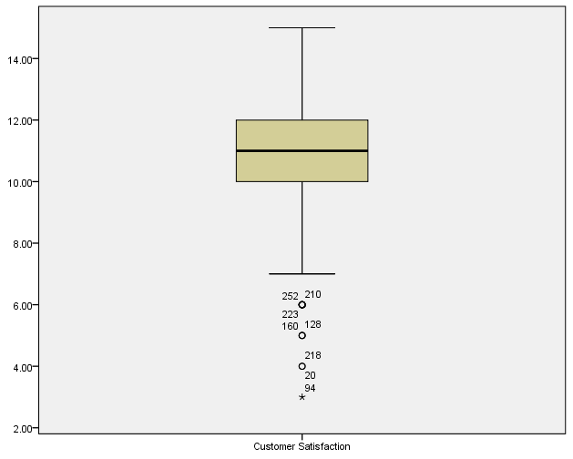
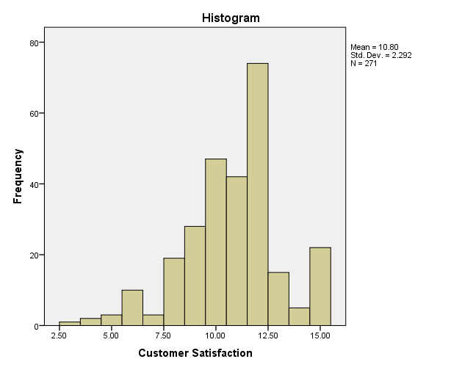
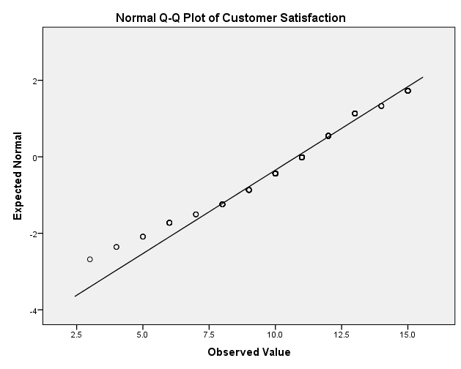
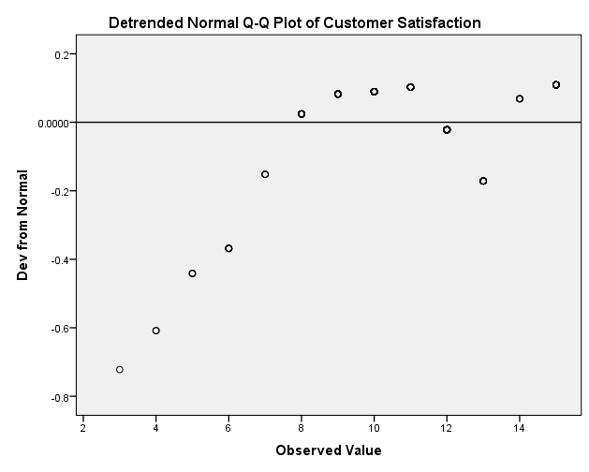
Normality Plots
Box Plot
Histogram

Slide 32
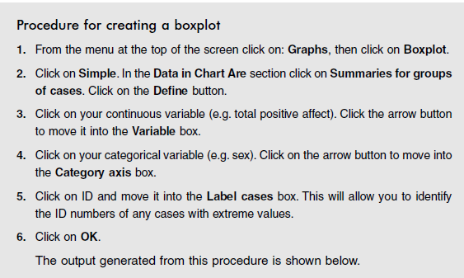
Boxplots
Boxplots are useful when you wish to compare the distribution of scores on variables.
Outlier
Outliers are cases with scores that are quite different from the remainder of the sample, either much higher or much lower.

Slide 33

OUTLIERS
Need to check Data whether there are any potential outliers existing in the analysis.
Pallant (2007) noted that “multiple regression is very sensitive to outliers (i.e. very high or low score)” (p. 165).
Outliers can influence the values of the estimated regression coefficients (Field, 2005).
Thus, outliers should be removed before running the regression analysis (Tabachnick & Fidell, 2007).
Multivariate outliers can be detected by using statistical methods such as casewise diagnostics, Mahalanobis distance, Cook’s distance and COVRATIO (Hair et al., 2006; Tabachnick & Fidell, 2007).
SPSS defi nes points as outliers if they extend more than 1.5 box-lengths from the edge of the box. Extreme points (indicated with an asterisk, *) are those that extend more than three box-lengths from the edge of the box

Slide 34
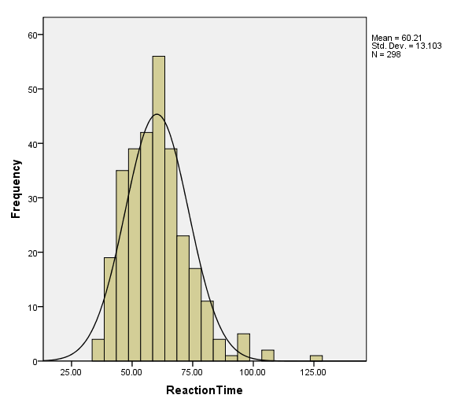
Histogram
A histogram is the most commonly used graph to show frequency distributions
Example: Single continuous variable such as Perceived stress score
Distribution may be
leptokurtic (peaked)
Positively skewed?
Need to run Explore.
Perceived Stress
Look at the tails of the distribution. Are there data points sitting on their own, out on the extremes? If so, these are potential outliers.

Slide 35
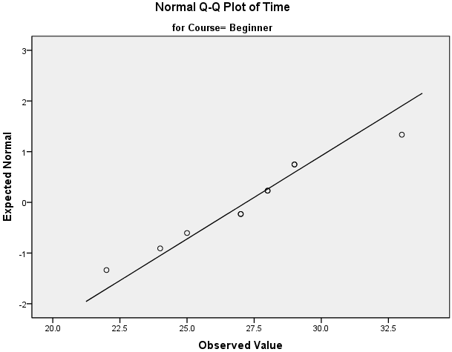
Normal Q-Q Plot
To determine normality graphically, we can use the output of a normal Q-Q Plot.
If the data are normally distributed, the data points will be close to the diagonal line.
If the data points stray from the line in an obvious non-linear fashion, the data are not normally distributed.

Slide 36
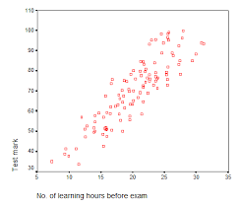
Scatterplots
Explore the relationship between 2 continuous variables
Example: No of learning hours and Test score
One of the best ways to look for relationships and patterns
The scatterplot will indicate whether the variables are related in a linear (straight line) OR curvilinear fashion
Only Linear relationships are suitable

Slide 37
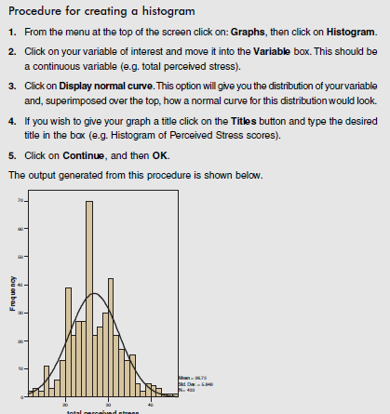
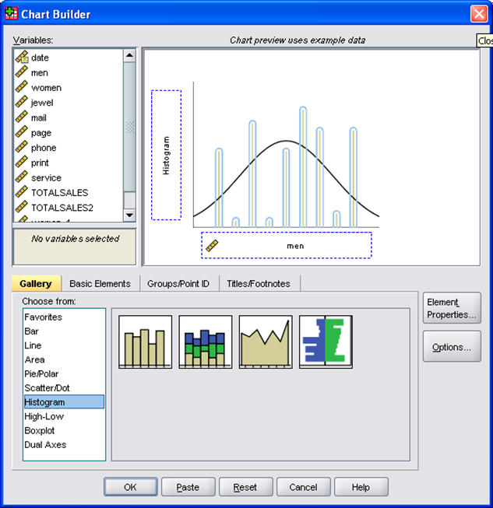
• histograms;
• bar graphs;
• scatterplots;
• boxplots;
• line graphs.
Graphs to describe and explore the data
Histograms
Histograms are used to display the distribution of a single
Continuous variable (e.g. age)

Slide 38
KEEP MOVING FORWARD

