Slide 1



Topic 11 Methods of Qualitative Data Analysis

Slide 2
What is qualitative Data Analysis
Qualitative data analysis is a process of gathering, structuring and interpreting qualitative data to understand what it represents.
Qualitative data is non-numerical and unstructured. Qualitative data generally refers to text, such as open-ended responses to survey questions or user interviews, but also includes audio, photos and video.
Qualitative research investigates the “softer side” of things to explore and describe, while quantitative research focuses on the “hard numbers”, to measure differences between variables and the relationships between them

Slide 3
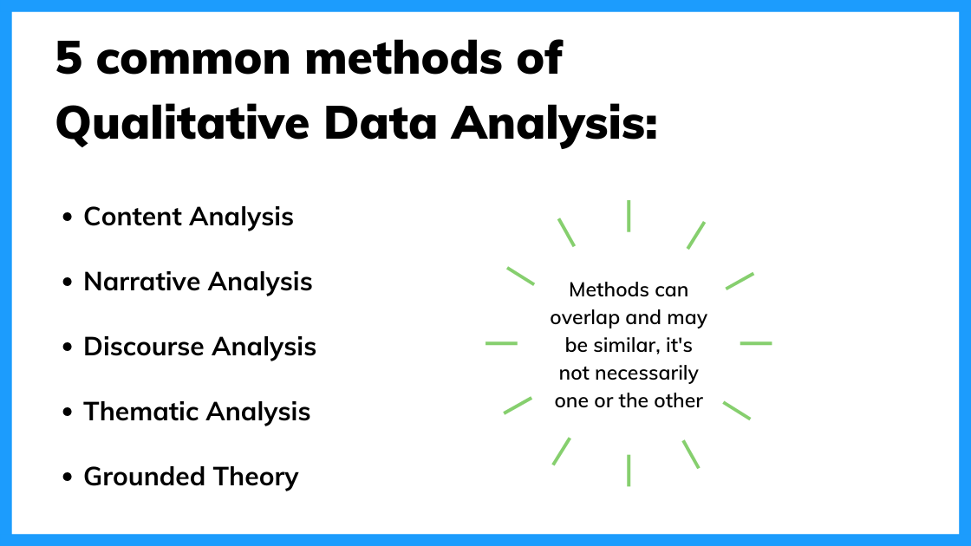
What are the common methods of qualitative data analysis

Slide 4
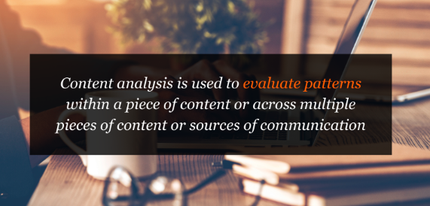
Content Analysis
Thematic analysis is a part of the content analysis.
Content analysis is used to identify the patterns that emerge from text, by grouping content into words, concepts, and themes.
Content analysis is useful to quantify the relationship between all of the grouped content.
Using content analysis, researchers can quantify and analyze the presence, meanings, and relationships of such certain words, themes, or concepts.
As an example, researchers can evaluate language used within a news article to search for bias or partiality.
Researchers can then make inferences about the messages within the texts, the writer(s), the audience, and even the culture and time of surrounding the text.

Slide 5
Description of Content Analysis
Sources of data could be from interviews, open-ended questions, field research notes, conversations, or literally any occurrence of communicative language (such as books, essays, discussions, newspaper headlines, speeches, media, historical documents).
A single study may analyze various forms of text in its analysis. To analyze the text using content analysis, the text must be coded, or broken down, into manageable code categories for analysis (i.e. “codes”).
Once the text is coded into code categories, the codes can then be further categorized into “code categories” to summarize data even further.

Slide 6

Uses of Content Analysis
Identify the intentions, focus or communication trends of an individual, group or institution
Describe attitudinal and behavioral responses to communications
Determine the psychological or emotional state of persons or groups
Reveal international differences in communication content
Reveal patterns in communication content
Pre-test and improve an intervention or survey prior to launch
Analyze focus group interviews and open-ended questions to complement quantitative data

Slide 7

Types of Content Analysis
There are two general types of content analysis: conceptual analysis and relational analysis.
Conceptual analysis determines the existence and frequency of concepts in a text.
Relational analysis develops the conceptual analysis further by examining the relationships among concepts in a text. Each type of analysis may lead to different results, conclusions, interpretations and meanings.

Slide 8

Narrative Analysis
Narrative analysis focuses on the stories people tell and the language they use to make sense of them.
It is particularly useful for getting a deep understanding of customers’ perspectives on a specific issue.
A narrative analysis might enable us to summarize the outcomes of a focused case study.

Slide 9

Narrative Analysis
Narrative analysis is all about listening to people telling stories and analysing what that means.
Since stories serve a functional purpose of helping us make sense of the world, we can gain insights into the ways that people deal with and make sense of reality by analysing their stories and the ways they’re told.
Eg: use narrative analysis to explore whether how something is being said is important. For instance, the narrative of a prisoner trying to justify their crime could provide insight into their view of the world and the justice system. Analysing the ways entrepreneurs talk about the struggles in their careers could provide powerful insights into their mindsets and perspectives. In other words, narrative analysis is about paying attention to the stories that people tell – and more importantly, the way they tell them.

Slide 10
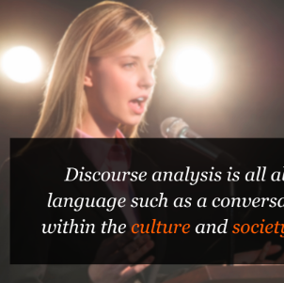
Discourse Analysis
Discourse analysis is used to get a thorough understanding of the political, cultural and power dynamics that exist in specific situations.
The focus here is on the way people express themselves in different social contexts.
Discourse analysis is commonly used by brand strategists who hope to understand why a group of people feel the way they do about a brand or product.

Slide 11
Discourse Analysis
Discourse is simply a fancy word for written or spoken language or debate. So, discourse analysis is all about analysing language within its social context.
In other words, analysing language – such as a conversation, a speech, etc – within the culture and society it takes place in. For example, you could analyse how a janitor speaks to a CEO, or how politicians speak about terrorism.
To truly understand these conversations or speeches, the culture and history of those involved in the communication is important. For example, a janitor might speak more casually with a CEO in a company that emphasises equality among workers. Similarly, a politician might speak more about terrorism if there was a recent terrorist incident in the country.

Slide 12
Thematic Analysis
Thematic analysis is used to deduce the meaning behind the words people use.
This is accomplished by discovering repeating themes in text.
These meaningful themes reveal key insights into data and can be quantified, particularly when paired with sentiment analysis.
Often, the outcome of thematic analysis is a code frame that captures themes in terms of codes, also called categories.
So the process of thematic analysis is also referred to as “coding”. A common use-case for thematic analysis in companies is analysis of customer feedback.

Slide 13
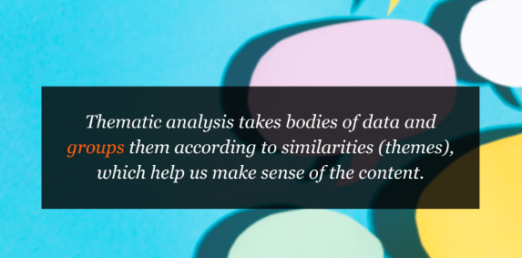
Thematic Analysis
Thematic analysis looks at patterns of meaning in a data set – for example, a set of interviews or focus group transcripts. But what exactly does that… mean?
A thematic analysis takes bodies of data (which are often quite large) and groups them according to similarities – in other words, themes.
These themes help us make sense of the content and derive meaning from it.

Slide 14
Thematic Analysis
Example:
With thematic analysis, you could analyse 20 transcripts on how retirees adjust after their retirement. By reviewing the data, you would then identify the themes that crop up repeatedly within the data – for example, “hobbies” or “friends”.
So, as you can see, thematic analysis can be pretty useful for finding out about people’s experiences, views, and opinions. Therefore, if your research aims and objectives involve understanding people’s experience or view of something, thematic analysis can be a great choice.

Slide 15
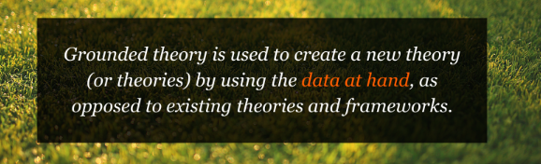
Grounded Theory
Grounded theory is a useful approach when little is known about a subject.
Grounded theory starts by formulating a theory around a single data case. This means that the theory is “grounded”.
It’s based on actual data, and not entirely speculative. Then additional cases can be examined to see if they are relevant and can add to the original theory.

Slide 16
Grounded Theory G Qualitative analysis method where the intention is to create a new theory (or theories) using the data at hand, through a series of “tests” and “revisions.”
Example: you could try to develop a theory about what factors influence students to read watch a YouTube video about qualitative analysis… The important thing with grounded theory is that you go into the analysis with an open mind and let the data speak for itself – rather than dragging existing hypotheses or theories into your analysis. In other words, your analysis must develop from the ground up (hence the name)…
After analyzing the interview data, a general hypothesis or pattern could emerge. For example, you might notice that graduate students are more likely to read a post about qualitative methods if they are just starting on their dissertation journey, or if they have an upcoming test about research methods.
From here, you’ll look for another small sample – for example, five more graduate students in a different department – and see whether this pattern or this hypothesis holds true for them. If not, you’ll look for commonalities and adapt your theory accordingly. As this process continues, the theory develops.
What’s important with grounded theory is that the theory develops from the data – not from some preconceived idea. You need to let the data speak for itself.

Slide 17
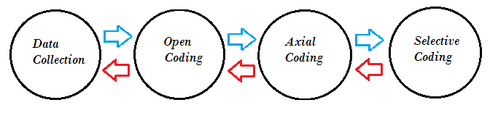
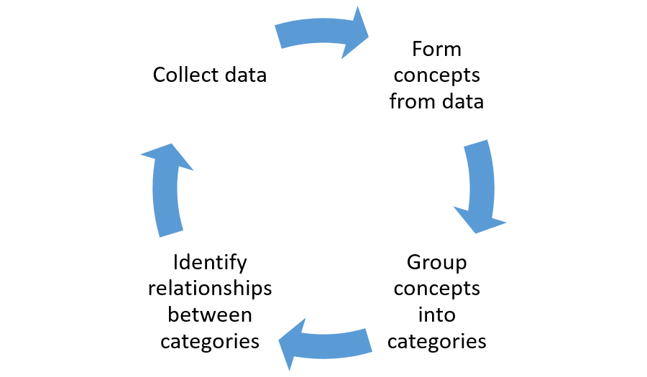
Grounded Theory
Data analysis should happen at the same time as data collection. You shouldn’t wait until all your data is collected before analyzing it; these methods should be fluid and change if your data uncovers a new theory or potential direction. This type of concurrent data analysis and data collection is often referred to as constant comparative analysis and theoretical sampling.
Coding should be line by line:
Open coding: read through data several times, creating summaries for the data using preliminary labels.
Axial coding is used to create conceptual families from the summaries,
Selective coding which turns the families into a formal framework with a variable that includes all of the collected data.

Slide 18
Thank You

