Slide 1
Qualitative Coding Process

Slide 2
Data Processing Data Analysis
Transcribing your data

Slide 3
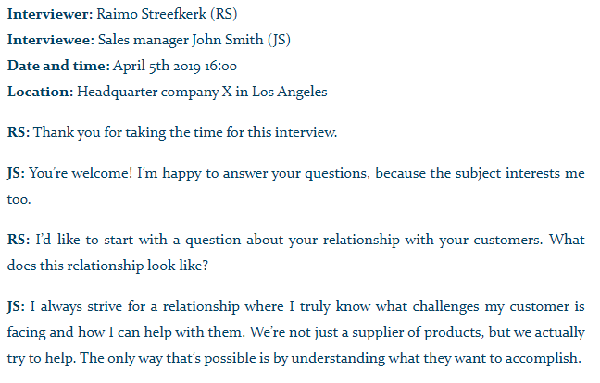
Transcribing your data Transcribing is converting speech to text word for word.
Transcription methods
1. Verbatim transcription
Write down every single word, including pauses, the expression of emotions such as laughter, stuttering, and hesitations such as “uh”.
2. Intelligent verbatim transcription (most common)
Write down every word, but without irrelevant fillers like “uhm”, “yeah”, “you know” etc. To improve readability, you can also fix grammar mistakes, broken sentences and long paragraphs
3. Edited transcription
A summarized and edited version of an intelligent verbatim transcript. In addition to omitting fillers like “you know”, irrelevant sentences can be omitted if it doesn’t change the meaning of the story.

Slide 4
Data Analysis
Data analysis is the process of making sense out of the data.
And making sense out of data involves:
consolidating,
reducing,
interpreting
what people have said and what the researcher has seen and read—it is the process of making meaning
Merriam and Tisdell

Slide 5
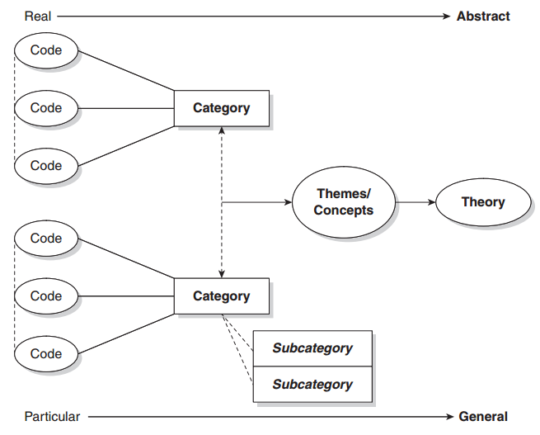
Data Analysis
Coding is the analytic process through which the qualitative data
that you have gathered are reduced

Slide 6
Thematic Analysis What is thematic analysis?
Thematic analysis is a method for identifying, analysing, and reporting patterns (themes) within data. It minimally organises and describes your data set in (rich) detail.
However, it also often goes further than this, and interprets various aspects of the research topic (Boyatzis, 1998).
The range of different possible thematic analyses will further be highlighted in relation to a number of decisions regarding it as a method
Thematic analysis is the study of patterns of meaning. In other words, it’s about analysing the themes within your data set to identify meaning. Most importantly, this process is driven by your research questions, so it’s not necessary to identify every possible theme in the data, but rather to focus on the key aspects that relate to your research questions.

Slide 7
Deductive and inductive approach
The inductive approach: .means the themes identified are strongly linked to the data themselves (Patton, 1990)
The inductive approach involves deriving meaning and creating themes from data without any preconceptions. In other words, you’d dive into your analysis without an idea of what themes will emerge, and thus allow themes to be determined by the data – to emerge from the data.
Example: If you’re investigating students' perceptions of inline learning, you’d enter the research without any preconceived themes or expected outcomes.
The deductive approach: means applying predetermined codes to the data.
A deductive approach involves jumping into your analysis with a set of themes that you already expect to find in your data. Usually, this approach is informed by prior knowledge and/or research and/or existing theory (which you’d cover in your literature review).
For example, if you’re analyzing Skills employees seek in graduates, you’d be able to draw themes such as “Communication” or “Creativity”, based on prior research into the topic.

Slide 8
Semantic vs Latent approach
Semantic Approach: The semantic approach ignores the underlying meaning of data, and identify themes based only on what is explicitly or overtly stated or written – in other words, things are taken at face value.
The themes are identified within the explicit or surface meanings of the data and the analyst is not looking for anything beyond what a participant has said or what has been written.
Latent Approach: focuses on underlying meanings and rather looks at the reasons for semantic content. A latent approach involves an element of interpretation,
Starts to identify or examine the underlying ideas, assumptions, and conceptualizations – and ideologies - that are theorized as shaping or informing the semantic content of the data.
Thus, for latent thematic analysis, the development of the themes themselves involves interpretative work, and the analysis that is produced is not just description but is already theorised.

Slide 9
CODING
Coding is the process perusing data for categories and meanings (themes, ideas, etc.) and then systematically marking similar strings of text with a code label.
CODE
A code in qualitative inquiry is most often a word or short phrase that symbolically assigns a summative, salient, essence capturing, and/or evocative attribute for a portion of language-based or visual data’
(Saldaña, 2013)
CATEGORY
‘(Q)ualitative codes are essence-capturing and essential elements of the research story, that, when clustered together according to similarity and regularity (a pattern), they actively facilitate the development of categories and thus analysis of their connections.’
(Saldaña, 2013: 8)Ñ

Slide 10
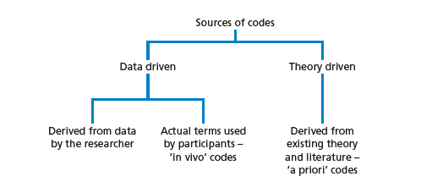
Steps in Coding
What is a code
Read through all transcripts
Start with one transcript
Identify text segments – ask “what is this person saying?”
Bracket text segment
Assign code word
Reduce redundancy
Collapse codes into themes
A code is a word, phrase, or sentence that represents aspect(s) of a data or captures the essence or feature(s) of a data

Slide 11
Data Analysis: how will we analyze it? The overall process
Codes the Text for
Description to be Used
in the Research Report
Codes the Text for
Themes to be Used
in the Research Report
The Researcher Codes the Data (i.e., locates text
segments and assigns a code to label them)
Interactive
Simultaneous
The Researcher Reads Through Data
( i.e., obtains general sense of material)
The Researcher Prepares Data for analysis
( e.g., transcribes fieldnotes)
The Researcher Collects Data (i.e., a text file, such as
Field notes, transcriptions, optically scanned material)

Slide 12
A Visual Model of the Coding Process in Qualitative Research
Divide text
into segments
of information
Label
segments of
information
with codes
Reduce
Overlap and
redundancy
of codes
Collapse
codes into
themes
Initially read
through data
Many
Pages
of Text
Many
Segments
of Text
Codes
reduced
to 20
30-40
codes
Reduce Codes to
5-7 Themes

Slide 13
Thematic Analysis – Braun and Clarke (2006)
Six-step process:
Familiarization
Coding
Generating themes
Reviewing themes
Defining and naming themes
Writing up

Slide 14
Thematic Analysis – Braun and Clarke
Step 1: Familiarization
The first step is to get to know our data. It’s important to get a thorough overview of all the data we collected before we start analyzing individual items.
This might involve transcribing audio, reading through the text and taking initial notes, and generally looking through the data to get familiar with it.
The first step in your thematic analysis involves getting a feel for your data and seeing what general themes pop up.
Braun, V., & Clarke, V. (2006). Using thematic analysis in psychology. Qualitative Research in Psychology, 3, 77–101.

Slide 15
Thematic Analysis – Step 2
Step 2: Coding
Coding means highlighting sections of our text – usually phrases or sentences – and coming up with shorthand labels or “codes” to describe their content.
Example
Perceptions of climate change among conservative voters aged 50 and up, and we have collected data through a series of interviews. An extract from one interview looks like this:
RQ: perceptions of climate change among conservative voters aged 50 and up,
In this extract, we’ve highlighted various phrases in different colors corresponding to different codes. Each code describes the idea or feeling expressed in that part of the text.
At this stage, we want to be thorough: we go through the transcript of every interview and highlight everything that jumps out as relevant or potentially interesting. As well as highlighting all the phrases and sentences that match these codes, we can keep adding new codes as we go through the text.
After we’ve been through the text, we collate together all the data into groups identified by code. These codes allow us to gain a a condensed overview of the main points and common meanings that recur throughout the data.

Slide 16
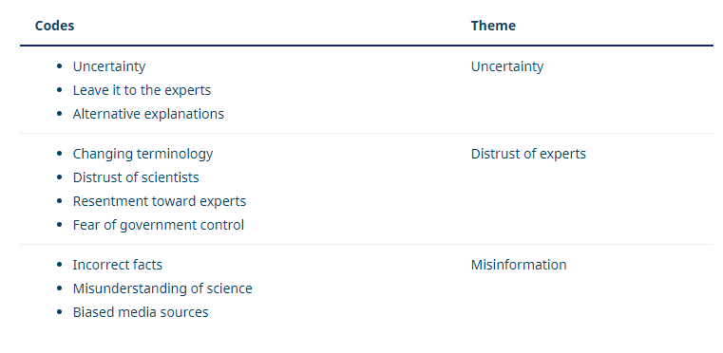
Thematic Analysis – Braun and Clarke
Step 3: Generating themes
Next, we look over the codes we’ve created, identify patterns among them, and start coming up with themes.
Themes are generally broader than codes. Most of the time, you’ll combine several codes into a single theme. In our example, we might start combining codes into themes like this:
At this stage, we might decide that some of our codes are too vague or not relevant enough (for example, because they don’t appear very often in the data), so they can be discarded.
Other codes might become themes in their own right. In our example, we decided that the code “uncertainty” made sense as a theme, with some other codes incorporated into it.
Again, what we decide will vary according to what we’re trying to find out. We want to create potential themes that tell us something helpful about the data for our purposes.
A theme captures something important about the data in relation to the research question and represents some level of patterned response or meaning within the data set.

Slide 17
Thematic Analysis – Braun and Clarke
Step 4: Reviewing themes
Now we have to make sure that our themes are useful and accurate representations of the data. Here, we return to the data set and compare our themes against it. Are we missing anything? Are these themes really present in the data? What can we change to make our themes work better?
If we encounter problems with our themes, we might split them up, combine them, discard them or create new ones: whatever makes them more useful and accurate.
For example, we might decide upon looking through the data that “changing terminology” fits better under the “uncertainty” theme than under “distrust of experts,” since the data labelled with this code involves confusion, not necessarily distrust.

Slide 18
Thematic Analysis – Step 5
Step 5: Defining and naming themes
Now that you have a final list of themes, it’s time to name and define each of them.
Defining themes involves formulating exactly what we mean by each theme and figuring out how it helps us understand the data.
Naming themes involves coming up with a succinct and easily understandable name for each theme.
For example, we might look at “distrust of experts” and determine exactly who we mean by “experts” in this theme. We might decide that a better name for the theme is “distrust of authority” or “conspiracy thinking”.

Slide 19
Thematic Analysis – Braun and Clarke
Step 6: Writing up
Writing up a thematic analysis requires an introduction to establish our research question, aims and approach.
Include a methodology section, describing how we collected the data (e.g. through semi-structured interviews or open-ended survey questions) and explaining how we conducted the thematic analysis itself.
The results or findings section usually addresses each theme in turn. We describe how often the themes come up and what they mean, including examples from the data as evidence. Finally, our conclusion explains the main takeaways and shows how the analysis has answered our research question.
In our example, we might argue that conspiracy thinking about climate change is widespread among older conservative voters, point out the uncertainty with which many voters view the issue, and discuss the role of misinformation in respondents’ perceptions.

Slide 20
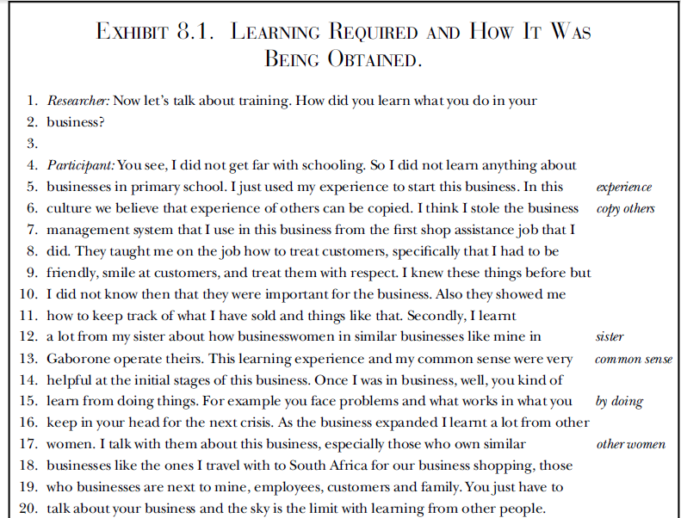
Sample
RQ1: How to learn what to do in business
Codes

Slide 21
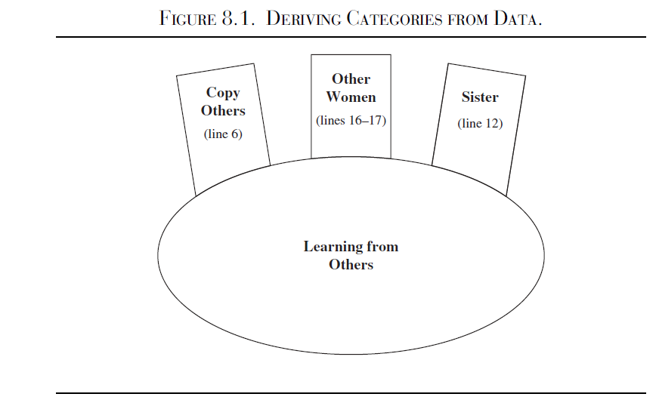

Slide 22
Content Analysis

Slide 23
Steps – Conceptual Analysis
Identify the research question and choose a sample or samples for analysis.
Next, the text must be coded into manageable content categories. This is basically a process of selective reduction. By reducing the text to categories, the researcher can focus on and code for specific words or patterns that inform the research question.
General steps for conducting a conceptual content analysis:
1. Decide the level of analysis: word, word sense, phrase, sentence, themes
2. Decide how many concepts to code for: develop a pre-defined or interactive set of categories or concepts. Decide either: A. to allow flexibility to add categories through the coding process, or B. to stick with the pre-defined set of categories.
Option A allows for the introduction and analysis of new and important material that could have significant implications to one’s research question.
Option B allows the researcher to stay focused and examine the data for specific concepts.

Slide 24
Steps – Conceptual Analysis
3. Decide whether to code for existence or frequency of a concept. The decision changes the coding process.
When coding for the existence of a concept, the researcher would count a concept only once if it appeared at least once in the data and no matter how many times it appeared.
When coding for the frequency of a concept, the researcher would count the number of times a concept appears in a text.
4. Decide on how you will distinguish among concepts:
Should text be coded exactly as they appear or coded as the same when they appear in different forms? For example, “dangerous” vs. “dangerousness”. The point here is to create coding rules so that these word segments are transparently categorized in a logical fashion. The rules could make all of these word segments fall into the same category, or perhaps the rules can be formulated so that the researcher can distinguish these word segments into separate codes.
What level of implication is to be allowed? Words that imply the concept or words that explicitly state the concept? For example, “dangerous” vs. “the person is scary” vs. “that person could cause harm to me”. These word segments may not merit separate categories, due the implicit meaning of “dangerous”.

Slide 25
Steps – Conceptual Analysis
5. Develop rules for coding your texts. After decisions of steps 1-4 are complete, a researcher can begin developing rules for translation of text into codes. This will keep the coding process organized and consistent. The researcher can code for exactly what he/she wants to code. Validity of the coding process is ensured when the researcher is consistent and coherent in their codes, meaning that they follow their translation rules. In content analysis, obeying by the translation rules is equivalent to validity.
6. Decide what to do with irrelevant information: should this be ignored (e.g. common English words like “the” and “and”), or used to reexamine the coding scheme in the case that it would add to the outcome of coding?
7. Code the text: This can be done by hand or by using software. By using software, researchers can input categories and have coding done automatically, quickly and efficiently, by the software program. When coding is done by hand, a researcher can recognize errors far more easily (e.g. typos, misspelling). If using computer coding, text could be cleaned of errors to include all available data. This decision of hand vs. computer coding is most relevant for implicit information where category preparation is essential for accurate coding.
8. Analyze your results: Draw conclusions and generalizations where possible. Determine what to do with irrelevant, unwanted, or unused text: reexamine, ignore, or reassess the coding scheme. Interpret results carefully as conceptual content analysis can only quantify the information. Typically, general trends and patterns can be identified.

Slide 26
Relational Analysis
Identify a research question and choose a sample or samples for analysis.
The research question must be focused so the concept types are not open to interpretation and can be summarized.
Next, select text for analysis. Select text for analysis carefully by balancing having enough information for a thorough analysis so results are not limited with having information that is too extensive so that the coding process becomes too arduous and heavy to supply meaningful and worthwhile results.

Slide 27
Relational Analysis
1. Determine the type of analysis: Once the sample has been selected, the researcher needs to determine what types of relationships to examine and the level of analysis: word, word sense, phrase, sentence, themes.
2. Reduce the text to categories and code for words or patterns. A researcher can code for existence of meanings or words.
3. Explore the relationship between concepts: once the words are coded, the text can be analyzed for the following:
Strength of relationship: degree to which two or more concepts are related.
Sign of relationship: are concepts positively or negatively related to each other?
Direction of relationship: the types of relationship that categories exhibit. For example, “X implies Y” or “X occurs before Y” or “if X then Y” or if X is the primary motivator of Y.

Slide 28
Relational Analysis
4. Code the relationships: a difference between conceptual and relational analysis is that the statements or relationships between concepts are coded.
5. Perform statistical analyses: explore differences or look for relationships among the identified variables during coding.
6. Map out representations: such as decision mapping and mental models.

Slide 29
Thank You

